Slide 1
Processor/Compiler Optimizations: The Road to Faster Applications
Beshoi Genidy

Slide 2
What this talk isn’t about ☹
How do compilers compile
Caches
Just in Time Execution
Increased clock speed
More transistors
Dataflow architectures
<Insert other important topic here>

Slide 3
Motivations for this Talk
Its on the edge of the Software/Hardware paradigm!!!

Slide 4
Processors
Notes:
I7 processor vlsi design

Slide 5
Processor Optimization Topics
Pipelines
Superscalar
Out-of-order execution
Register Renaming
Branch Prediction
Speculative execution
ILP (Instruction Level Parallelism)

Slide 6
What are Pipelines
Pipeline is a set of data processing elements connected in series, where the output of one element is the input of the next one.
A typical 5 stage pipeline consists of the following 5 stages: IF (instruction fetch), ID (instruction decode), EX (execute), MEM (memory access), WB (write back)
Think of computer pipelines as the equivalence of the assembly line. Due to there use throughput is much higher!!!
https://en.wikipedia.org/wiki/Classic_RISC_pipeline
Notes:
IF
Fetch the next instruction needed
ID
Decode the instruction type resolve register values
EX
Exec the op that was decoded
MEM
Do any loads/stores that might be needed (if branch then increment PC (program counter))
WB
Write the result to the proper register location
Intels original Pentium architecture had 5 stages now I believe the i3, i5, and i7 have 14 stages
While others have gone up to 31 pipeline stages it was found to reach a limit that started decreasing throughput

Slide 7
Pipeline drawbacks
Hazards!!!!!!!!!
Example Assembly:
Add 1 to R5
Copy R5 to R6
Notes:
RAW: Read after write (happen with conventional pipelines)
WAR: Write after read (only happens with out-of-order/parallel pipelines)
WAW: write after write (only happens with out-of-order/parallel pipelines)
Solutions:
Compilers usually help out to organize code in a way that hopefully minimizes these
Processor if it detects one of those hazards will create bubbles in the pipeline by stalling the execution of the hazardous op until the other op has been successfully finished.

Slide 8
Superscalar processors
It is a form of parallelism!
They can execute more than one instruction during a clock cycle by dispatching multiple instructions to different execution units.
Important to realize this is not referring to multi-core processing or software level parallelism but is referring to a single CPU core having multiple pipelines for increased throughput.
Also important to realize that while superscalar CPU is typically also pipelined they are not the same thing.
https://en.wikipedia.org/wiki/Superscalar_processor
Notes:
Scalar processors have a single execution unit i.e at any given clock cycle it can only execute one operation.
Superscalar has multiple units of execution so it can process multiple operations concurrently

Slide 9
Out-of-order Execution
Commonly referred to as dynamic execution
Rather than doing sequential execution of instructions which often times results in stalls do to data dependencies, the processor attempts to reorder some of the operations to execute instructions based on availability (i.e. if an instruction can be executed without any harm and the proceeding instructions aren’t ready yet then rearrange the order of the ops to have that instruction go first).
Example:
Load R1, 0(R2)
Add R2, R1, R3
Add R4, R3, R5
http://hpca23.cse.tamu.edu/taco/utsa-www/cs5513-fall07/lecture5.html
Notes:
Solution:
Since step 1 requires memory access, rather than stalling to get the data so that we can execute step 2, lets just execute step 3 before step 2.
So the processor would reorder it as such
Load R1, 0(R2)
Add R4, R3, R5
Add R2, R1, R3

Slide 10
Register Renaming
Is the technique that eliminates the false data dependencies arising from the reuse of architectural registers by successive instructions that do not have any real data dependencies between them.
Register renaming increases ILP!!!
Consider the following piece of code:
R1 = M[1024]
R1 = R1 + 2
M[1032] = R1
R1 = M[2048]
R1 = R1 + 4
M[2056] = R1
Can you rename some of these registers to eliminate false data dependencies?
https://en.wikipedia.org/wiki/Register_renaming
Notes:
Answer:
Yes and here is a proposed solution:
Original
R1 = M[1024]
R1 = R1 + 2
M[1032] = R1
R1 = M[2048]
R1 = R1 + 4
M[2056] = R1
Improved
R1 = M[1024]
R1 = R1 + 2
M[1032] = R1
R2 = M[2048]
R2 = R2 + 4
M[2056] = R2

Slide 11
Branch Prediction
A simple as it sounds (at least the concept is ☺)
Computer architecture attempts to predict if a branch will be taken or not.
http://ece-research.unm.edu/jimp/611/slides/chap4_5.html

Slide 12
What is speculative execution
Work is done before it is known whether it is actually needed, to prevent delays that would have to be incurred by doing the work after it is known that it is needed.
If the work is found as not needed then simply discard the results and revert back all changes. (thought to be ok in a pre SPECTRE and MELTDOWN world)
Example:
t = a+b
u = t+c
v = u+d
if v:
w = e+f
x = w+g
y = x+h
https://www.raspberrypi.org/blog/why-raspberry-pi-isnt-vulnerable-to-spectre-or-meltdown/

Slide 13
ILP (Instruction Level Parallelism)
Two approaches to ILP
Hardware
Dynamic parallelism (i.e at runtime the processor decides which instructions should be execute in parallel)
Software
Static parallelism (i.e at compile time the compiler decides which instructions should be executed in parallel)
ILP is very application specific (it depends on how much each piece of data in your application relies on one another)
Example Program:
e = a + b
f = c + d
m = e * f
Step 1 and Step 2 don’t rely on each other hence can be executed in parallel!!
So in an ILP capable system the following program would take 2 cycles to complete rather than 3 cycles (assuming that each operation takes 1 cycle to complete)
https://en.wikipedia.org/wiki/Instruction-level_parallelism
Notes:
Here is a list of the set of Micro-architecture techniques used to exploit ILP:
Instruction pipelining
Superscalar
Out-of-order execution
Register renaming
Speculative execution
Branch prediction
ILP is also more utilized in graphics and scientific but not so much in crypto.

Slide 14
Compilers
“Computes are dumb actors and compilers/programmers are the master playwrights”
“A large part of modern out of order processors is hardware that could have been eliminated if a good compiler existed…. A large part of modern out of order processors was designed because computer architects thought compiler writers could not do a good job.”
Compiler logic, hmmmmmm: replace while(1) to for(;;) …. I have optimized all the codes
www.cs.utexas.edu/users/mckinley/pl...2007/presentations/.../panel-plw-2007.ppt

Slide 15
Compiler Optimization Topics
Algebraic simplifications
Loops
Invariant code (also known as code hoisting)
Unrolling
Function Inlining
Dead code elimination
Global optimizations

Slide 16
A bit about compilers…
Must preserve the semantic equivalence of the programs.
Algorithm should not be modified.
Transformations should hopefully make the program faster.
When in doubt be as conservative as possible (back to the first point).
Compilers have machine dependent and machine independent optimizations.
www.iitg.ernet.in/dgoswami/resource/Code-Optimization.ppt

Slide 17
Algebraic simplifications/Constant folding
Replace costly operations with simpler ones. For example (16*x) should be replaced with (x<<4)
Constant folding is the evaluation of constant expressions at compile time rather than computing them at runtime. For example (x = 54*12*17) would be replaced with (x = 11016)
https://en.wikipedia.org/wiki/Constant_folding
Notes:
Constant folding also understands identities so things lix 0 * x will always be zero regardless of ”x” value so the compiler never even has to fetch x.

Slide 18
Code Hoisting
Statements or expressions that can be moved outside of the body of a loop without affecting the semantics of the program.
Example:
for (int i = 0; i < n; i++) {
x = y + z;
a[i] = 6 * i + x * x;
}
https://en.wikipedia.org/wiki/Loop-invariant_code_motion
Notes:
Solution:
x = y + z;
temp = x * x;
for (int i = 0; i < n; i++) {
a[i] = 6 * i + temp;
}

Slide 19
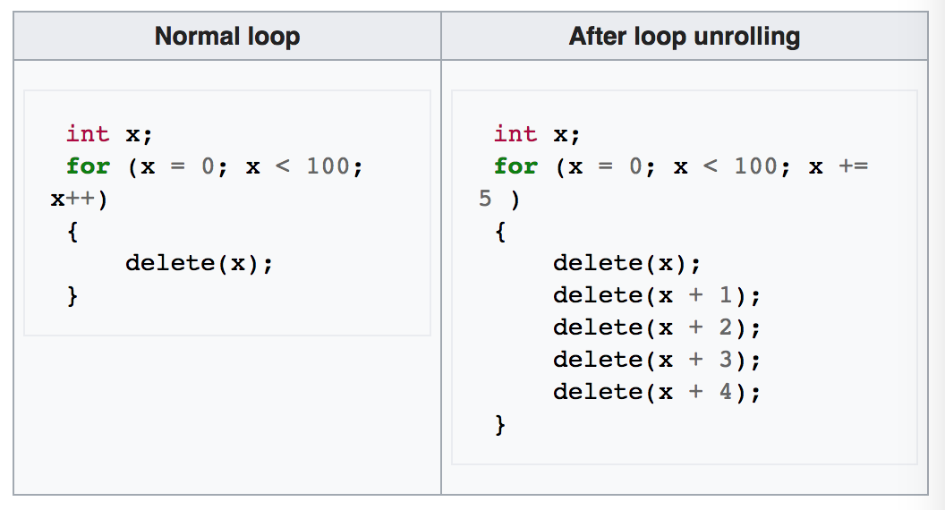
Loop Unrolling
Is a loop transformation technique that attempts to optimize program execution speed at the expense of its binary size.
Optimization works by expanding the loop so less loop control (loop iterations) instructions are executed, obviously this will result in a larger code base.
https://en.wikipedia.org/wiki/Loop_unrolling
Notes:
90% of the time is spent in 10% of the code
- Important to note that this is one of those that compilers tend to want to know the underlying architecture for because if unrolling too much you may run out of registers which would cause more memory access and slower performance.

Slide 20
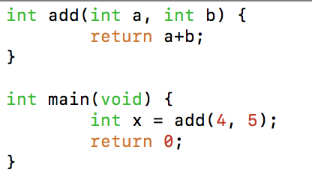
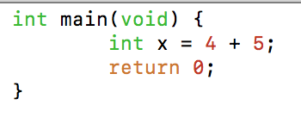
Function inlining
is the replacement of a function call with the actual body of the function.

Slide 21
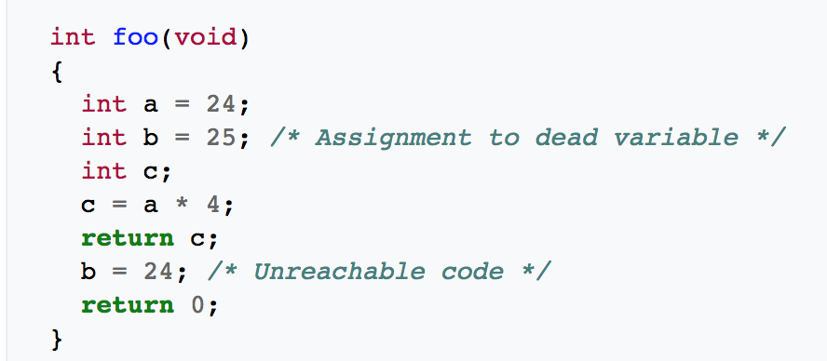
Dead code elimination
The removal of code which does not affect the program results.
Benefits:
include faster computation time due to less operations to execute.
Smaller application size due to the removal of the unneeded code.
https://en.wikipedia.org/wiki/Dead_code_elimination
Notes:
- Sometimes its useful from a dev point of view:
Example
#defing DEBUG 0
If (DEBUG) {
printf(“important debug information”);
}
Compiler will see if(0) and eliminate the entire section of code since it was not compiled in debug mode!

Slide 22
Global optimizations
Optimizations can be extended to an entire control-flow graph.
Usually done on function levels with worst case assumptions regarding outside calls or use of global variables.

Slide 23
Optimize the following…
int foo(int *a, int *b) {
*a = 2;
*b = 3;
return *a+*b;
}
Notes:
Solution:
It’s a trick the following code code rarely be optimized by a compiler unless detected through a global optimization.
In most cases the user will assume that the function returns 5 all the time; however that is not the case if both pointer “a” and pointer “b” are the same pointer.
int x = 0;
printf(“%d\n”, foo(&x, &x)); // returns 6 rather than 5

Slide 24
Future of compilers
“Optimization for scalar machines is a problem that was solved ten years ago.” – David Kuck, Fall 1990
Maybe for 1990 standards but in todays world a few things are evolving:
Architectures keep changing
Languages keep changing
Applications keep changing
When to compile keeps changing
www.cs.utexas.edu/users/mckinley/380C/lecs/01.pp

Slide 25
Questions?

